Slide 1
ISW Developer Academy
3rd of December, 2018

Slide 2
Introduction
Journey into the Agile World
Agile Manifesto
Agile Software Development
Scrum Framework
Scrum Events
Scrum Artifacts
Class Activity
Key Terminologies
Kanban: An alternative to Scrum

Slide 3
Journey into the Agile World

Slide 4
Journey into the Agile World
Waterfall model was adopted in the 20th century for software development
It mimicked a similar approach used in manufacturing or construction
It is plagued with some problems, majorly
Not change receptive
No working software until late in the process
Leading to high failure rate for software development
Generally not suitable for software development of today that is driven by a largely fluid business
Where requirements are not completely known or clear
Long, ongoing projects
Technology is not well understood and so on.
Notes:
Products in these industries are similar e.g cars, bottle water, etc. The production line is setup to produce similar output. This is unlike IT products
Change can arise from the business or customer, technology, etc. This can potentially lead to loss of time, money/investment and diminishing brand value or reputation
Projects in construction is linear or sequential, thus agile method can only be applied in the pre-design and design phase

Slide 5
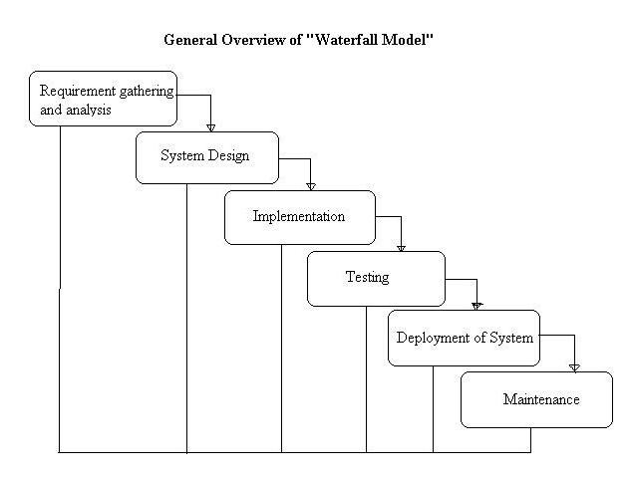
Journey into the Agile World
Retrieved from: http://tryqa.com/what-is-waterfall-model-advantages-disadvantages-and-when-to-use-it/
Notes:
In use in the 70s till the 90s
Outcome of step 1 – Product requirement document/FRD/BRD
Step 2 – System Architecture and other design documents, e.g. Use case diagrams
Step 3 – Software/code

Slide 6
Agile Manifesto

Slide 7
Agile Manifesto
Agile Manifesto
In 2001, the Agile Manifesto was published by a group of software engineers
It rides on some underlining lightweight software development methodologies
Emphasizes on continuous delivery and improvement, collaboration, and openness to change
Comprises a list of values and principles
Individuals and Interactions over processes and tools
Working Software over comprehensive documentation
Customer Collaboration over contract negotiation
Responding to Change over following a plan
Values of Agile
Notes:
** Marketing, or management, or external customers, internal customers, and, yes, even developers—don’t want to make hard trade-off decisions, so they impose irrational demands through the imposition of corporate power structures
** In order to succeed in the new economy, to move aggressively into the era of volatile market condition…
** Seventeen leading figures in the software industry came up with the manifestos based on their experience of what approaches do and do not wok for software development.
** Agile movement is not anti-methodology, in fact, many of us want to restore credibility to the word methodology. We want to restore a balance. We embrace modeling, but not in order to file some diagram in a dusty corporate repository. We embrace documentation, but not hundreds of pages of never-maintained and rarely-used tomes. We plan, but recognize the limits of planning in a turbulent environment.

Slide 8
Agile Manifesto
Agile Manifesto
Customer satisfaction by early and continuous delivery of valuable software
Welcome changing requirements, even in late development
Working software is delivered frequently (weeks rather than months)
Close, daily cooperation between business people and developers
Projects are built around motivated individuals, who should be trusted
Face-to-face conversation is the best form of communication (co-location)
Working software is the primary measure of progress
Sustainable development, able to maintain a constant pace
Continuous attention to technical excellence and good design
Simplicity—the art of maximizing the amount of work not done—is essential
Best architectures, requirements, and designs emerge from self-organizing teams
Regularly, the team reflects on how to become more effective, and adjusts accordingly

Slide 9
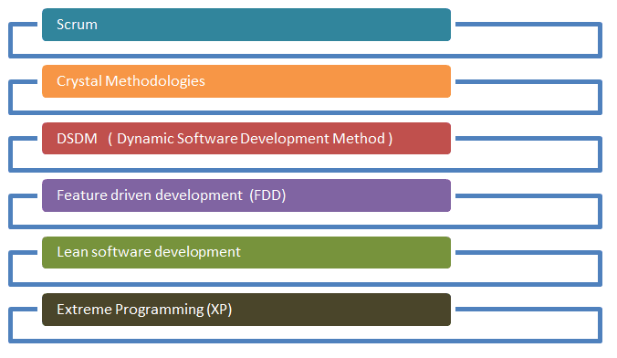
Agile Manifesto
This led to the evolution of some lightweight methods of developing software
These methodologies share something in common… incremental and iterative nature
Examples are
Source: https://www.guru99.com/agile-scrum-extreme-testing.html
Notes:
** “Lightweight” means that the overhead of the process is kept as small as possible, to maximize the amount of productive time available for getting useful work done
Open to change: requirements change for varying reasons… technology, competition, software becoming obsolete… change is just almost certain. Agile makes room for unplanned adjustment, early testing bringing about customer feedback and continuous improvement

Slide 10
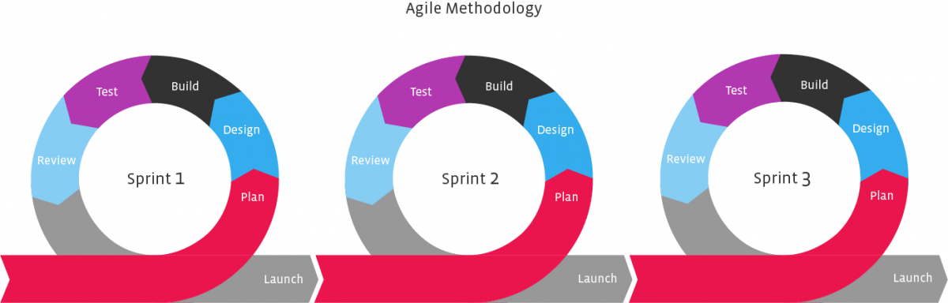
Agile Manifesto

Slide 11
Agile Software Development

Slide 12
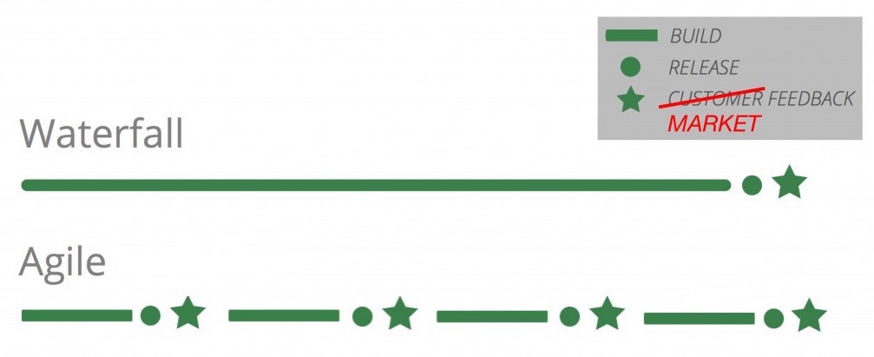
Agile Software Development
Agile Software Development
Spun out of the manifesto and basically rides on the values and principles in the manifesto
Each step involves requirement capture, analysis and design, coding, testing, deployment, maintenance and bug fixes.
Source: https://www.blossom.co/blog/agile-software-history
Notes:
** Agile software development refers to a group of software development methodologies based on iterative development, where requirements and solutions evolve through collaboration between self-organizing cross-functional teams. Agile methods or Agile processes generally promote a disciplined project management process that encourages frequent inspection and adaptation, a leadership philosophy that encourages teamwork, self-organization and accountability, a set of engineering best practices intended to allow for rapid delivery of high-quality software, and a business approach that aligns development with customer needs and company goals. Agile development refers to any development process that is aligned with the concepts of the Agile Manifesto.
** Open to change: requirements change for varying reasons… technology, competition, software becoming obsolete… change is just almost certain. Agile makes room for unplanned adjustment, early testing bringing about customer feedback and continuous improvement

Slide 13
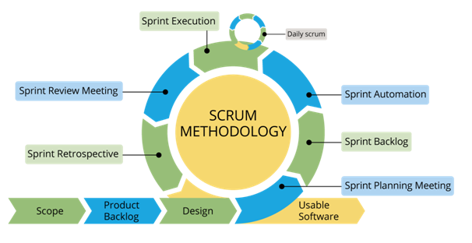
Agile @ ISW
Agile Software Development
Source: https://dzone.com/articles/battle-of-pm-methodologies-waterfall-vs-agile-vs-s

Slide 14
Scrum Framework

Slide 15
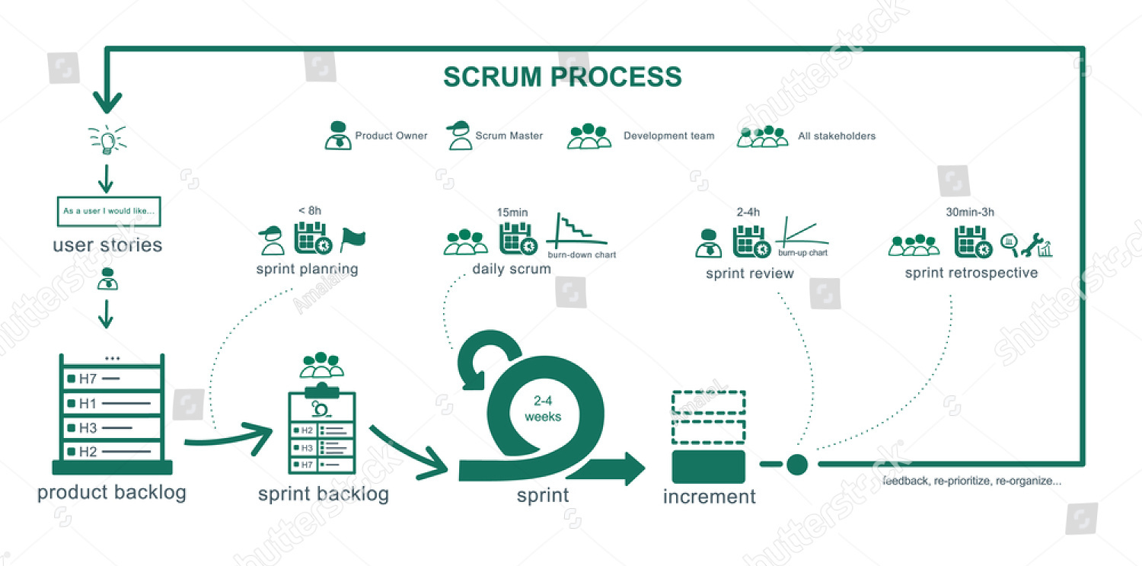
Scrum Summarized
Scrum Framework
Retrieved from https://www.shutterstock.com/image-vector/scrum-process-summary-full-agile-methodology-758441260

Slide 16
Scrum Framework
Scrum Framework
The most popular Agile Framework
It’s a framework, not a methodology
A framework for developing and sustaining complex products
The most authoritative resource on Scrum is the Scrum Guide, which is available at scrumguides.org
The framework consists of
Scrum Teams and their associated
roles,
events,
artifacts,
and rules.
Notes:
It's abstract and is not prescriptive. That is, If you imagine Scrum as a fitness guide, it will recommend general guidance on healthy eating habits and lifestyle choices, but it won't tell you exactly what to eat and specifically which exercises you should do
*** The rules of Scrum bind together the roles, events, and artifacts, governing the relationships and interaction between them.

Slide 17
Scrum Value
Scrum Framework
Scrum values are embodied and lived by the Scrum Team
Scrum Values are commitment, courage, focus, openness and respect
Successful use of Scrum depends on people becoming more proficient in living these five values
Notes:
People personally commit to achieving the goals of the Scrum Team. The Scrum Team members have courage to do the right thing and work on tough problems. Everyone focuses on the work of the Sprint and the goals of the Scrum Team. The Scrum Team and its stakeholders agree to be open about all the work and the challenges with performing the work. Scrum Team members respect each other to be capable, independent people
*** When the values of commitment, courage, focus, openness and respect are embodied and lived by the Scrum Team, the Scrum pillars of transparency, inspection, and adaptation come to life and build trust for everyone. The Scrum Team members learn and explore those values as they work with the Scrum events, roles and artifacts.

Slide 18
Scrum Team
A scrum team consists of
a Product Owner
the Development Team and
a Scrum Master
Scrum Teams are self-organizing
Scrum Teams are cross-functional
The Product Owner is responsible for maximizing the value of the product resulting from work of the Development Team.
Solely accountable for managing the Product Backlog
May be responsible for managing it or the development team
Product Owner
Notes:
Self-organizing teams choose how best to accomplish their work, rather than being directed by others outside the team. Cross-functional teams have all competencies needed to accomplish the work without depending on others not part of the team. It gives room for flexibility, creativity, and productivity to be optimized
For the Product Owner to succeed, the entire organization must respect his or her decisions

Slide 19
Development Team
Scrum Team
Consists of professionals who do the work of delivering a potentially releasable increment of a product at the end of each Sprint
Team size is small enough to remain nimble and large enough to complete significant work within a Sprint
Optimal size is 3 to 9
Product Owner and Scrum Master roles are not included in this count unless they are also executing the work of the Sprint Backlog
Responsible for promoting and supporting Scrum as defined in the Scrum Guide
Helping people understand Scrum theory, practices, rules, and values
Is a servant-leader for the Scrum Team
Helps those outside the Scrum Team understand which of their interactions with the Scrum Team are helpful and which aren’t
Scrum Master

Slide 20
Scrum Master
Scrum Team
Scrum Master Service to the Product Owner
Generally responsible ensuring that the product backlog is well understood by the team and well managed
Ensuring that goals, scope, and product domain are understood by everyone on the Scrum Team as well as possible;
Finding techniques for effective Product Backlog management;
Ensuring the Product Owner knows how to arrange the Product Backlog to maximize value;
Understanding and practicing agility; and,
Facilitating Scrum events as requested or needed
Scrum Master Service to the Development Team
Coaching the team to be self organizing
Helping to remove impediments
Removing impediments to the Development Team’s progress;
Facilitating Scrum events as requested or needed; and,
Coaching the Development Team in organizational environments in which Scrum is not yet fully adopted and understood
Notes:
Scrum Master Service to the Product Owner
Ensuring that goals, scope, and product domain are understood by everyone on the Scrum Team as well as possible;
Finding techniques for effective Product Backlog management;
Ensuring the Product Owner knows how to arrange the Product Backlog to maximize value;
Understanding and practicing agility; and,
Facilitating Scrum events as requested or needed.
Scrum Master Service to the Development Team
Coaching the Development Team in self-organization and cross-functionality;
Helping the Development Team to create high-value products;
Removing impediments to the Development Team’s progress;
Facilitating Scrum events as requested or needed; and,
Coaching the Development Team in organizational environments in which Scrum is not yet fully adopted and understood.

Slide 21
Scrum Master
Scrum Team
Scrum Master Service to the Organization
Leading and coaching the organization in its Scrum adoption;
Planning Scrum implementations within the organization;
Helping employees and stakeholders understand and enact Scrum and empirical product development;
Causing change that increases the productivity of the Scrum Team; and,
Working with other Scrum Masters to increase the effectiveness of the application of Scrum in the organization
Notes:
Scrum Master Service to the Organization
Leading and coaching the organization in its Scrum adoption;
Planning Scrum implementations within the organization;
Helping employees and stakeholders understand and enact Scrum and empirical product development;
Causing change that increases the productivity of the Scrum Team; and,
Working with other Scrum Masters to increase the effectiveness of the application of Scrum in the organization

Slide 22
Scrum Events

Slide 23
Scrum Events
Scrum Events
Are prescribed events to create regularity and to minimize the need for meetings not defined in Scrum
All events are time-boxed
Designed to enable critical transparency, inspection and adaption
Each event in Scrum is a formal opportunity to inspect and adapt something
The heart of Scrum is a Sprint
Sprints are used to accomplish something
A sprint is timeboxed to 1 to 4 weeks
Sprints also limit risk to 4 weeks of cost
A "Done", useable, and potentially releasable product Increment is created
The Sprint is a container for all other events, namely
Sprint Planning
Daily Scrum
Sprint Review
Sprint Retrospective
Notes:
Sprints are limited to one calendar month. When a Sprint’s horizon is too long the definition of what is being built may change, complexity may rise, and risk may increase

Slide 24
The Sprint
Scrum Events
During the Sprint:
No changes are made that would endanger the Sprint Goal;
Quality goals do not decrease; and,
Scope may be clarified and re-negotiated between the Product Owner and Development Team as more is learned
A Sprint can be cancelled before the Sprint time-box is over
Product owner has the authority
The product owner may cancel under influence from the stakeholders, the Development Team, or the Scrum Master
Notes:
A Sprint would be cancelled if the Sprint Goal becomes obsolete. This might occur if the company changes direction or if market or technology conditions change. In general, a Sprint should be cancelled if it no longer makes sense given the circumstances. But, due to the short duration of Sprints, cancellation rarely makes sense.
When a Sprint is cancelled, any completed and "Done" Product Backlog items are reviewed. If part of the work is potentially releasable, the Product Owner typically accepts it. All incomplete Product Backlog Items are re-estimated and put back on the Product Backlog.

Slide 25
Sprint Planning
Scrum Events
Time-boxed to a maximum of eight hours for a one-month Sprint, and usually shorter for shorter sprints
Scrum Master ensures that the event takes place and that attendants understand its purpose
Sprint Planning answers the questions
What to be delivered in the next product increment
How will the work or increment be achieved
Product backlog is an input to sprint planning
During Sprint Planning the Scrum Team crafts a Sprint Goal
The Sprint Goal is an objective set for the Sprint that can be met through the implementation of Product Backlog
The development team designs the system and the work needed to convert the Product Backlog into a working product Increment
Work items are decomposed to form Sprint backlog
Work items are estimated during sprint planning

Slide 26
Scrum Events
Daily Scrum
It’s a 15-minute time-boxed event for the Development Team
It is held every day of the Sprint
Daily Scrum is held at the same time and place each day to reduce complexity
Progress is inspected toward achieving the Sprint goal
It addresses this basic questions
What did I do yesterday that helped the Development Team meet the Sprint Goal?
What will I do today to help the Development Team meet the Sprint Goal?
Do I see any impediment that prevents me or the Development Team from meeting the Sprint Goal?
The Scrum Master ensures that the meeting holds but the development team is responsible for conducting the meeting
Scrum Master ensures the meeting is not more than 15 minutes and the meeting agenda is not disrupted
Daily Scrums improve communications, eliminate other meetings, identify impediments to development for removal, highlight and promote quick decision-making

Slide 27
Scrum Events
Sprint Review
Held at the end of the Sprint to inspect the Increment and adapt the Product Backlog if needed
Feedback is gathered
Time-boxed to 4-hour at most for a one-month sprint, usually shorter for shorter sprints
Scrum master ensures it takes place and attendees understand its purpose
The result of the Sprint Review is a revised Product Backlog
Include the following elements
Attendees include the Scrum Team and other stakeholders (internal and/or external)
The Development Team discusses what went well during the Sprint, what problems it ran into, and how those problems were solved
The Development Team demonstrates the work that it has "Done" and answers questions about the Increment;
The Product Owner discusses the Product Backlog as it stands
The entire group collaborates on what to do next
Review of how the marketplace or potential use of the product might have changed
Review of the timeline, budget, potential capabilities, and marketplace for the next anticipated releases of functionality or capability of the product

Slide 28
Sprint Retrospective
Scrum Events
Presents an opportunity for the scrum team to inspect itself and plans for improvement in the next sprint
Occurs after the Sprint Review, prior to the next Sprint Planning
Time-boxed to at most 3 hours for a 1 month sprint, usually shorter for shorter sprints
Scrum master ensures it takes place and productive
It’s gives an opportunity to inspect the scrum team and adapt improvements identified
Attendees are the scrum team members
The purpose is to
Inspect how the last Sprint went with regards to people, relationships, process, and tools;
Identify and order the major items that went well and potential improvements; and,
Create a plan for implementing improvements to the way the Scrum Team does its work
Notes:
Whereas the sprint review is a time to inspect and adapt the product, the sprint retrospective is an opportunity to inspect and adapt the process. During the retrospective, teams are free to examine what’s happening, analyze the way they work, identify ways to improve, and make plans to implement these improvements. Anything that affects how the team creates the product is open to scrutiny and discussion, including processes, practices, communication, environment, artifacts, tools, and so on.

Slide 29
Scrum Artifacts

Slide 30
Product Backlog
Scrum Artifacts
Represent work or value to provide transparency of key information
They are
Product Backlog
Sprint Backlog
Increment
It is an ordered list of everything known that is needed in the product
It is a list of all features, functions, requirements, enhancements, and fixes that constitute the changes to be made to the product in future releases
Product owner is responsible for the product backlog, its content, availability and ordering
It is dynamic and evolves as the product and the environment in which it will be used evolves
Constantly changes to identify what the product needs to competitive and useful
Refined through the act of adding detail, estimates, and order to items in the Product Backlog
Notes:
As a product is used and gains value, and the marketplace provides feedback, the Product Backlog becomes a larger and more exhaustive list. Requirements never stop changing, so a Product Backlog is a living artifact. Changes in business requirements, market conditions, or technology may cause changes in the Product Backlog.

Slide 31
Product Backlog
Scrum Artifacts
This is an ongoing process in which the Product Owner and the Development Team collaborate on the details of Product Backlog items
Higher ordered Product Backlog items are usually clearer and more detailed than lower ordered ones. The lower the order, the lesser the detail
Product Backlog items that can be "Done" by the Development Team within one Sprint are deemed "Ready" for selection in a Sprint Planning
Notes:
As a product is used and gains value, and the marketplace provides feedback, the Product Backlog becomes a larger and more exhaustive list. Requirements never stop changing, so a Product Backlog is a living artifact. Changes in business requirements, market conditions, or technology may cause changes in the Product Backlog.

Slide 32
Sprint Backlog
Scrum Artifacts
The Sprint Backlog is the set of Product Backlog items selected for the Sprint
It comprises of work needed to meet the Sprint goal
A sprint backlog can be modified the Sprint Backlog throughout the Sprint
As new work is required, the Development Team adds it to the Sprint Backlog
When elements of the plan are deemed unnecessary, they are removed
Only the Development Team can change its Sprint Backlog during a Sprint
It belongs solely to the Development Team
The Development Team tracks this total work remaining at least for every Daily Scrum to project the likelihood of achieving the Sprint Goal

Slide 33
Sprint Backlog
Scrum Artifacts
The Increment is the sum of all the Product Backlog items completed during a Sprint and all previous Sprints
At the end of a Sprint, the new Increment must be "Done," which means it must be in useable condition and meet the Scrum Team’s definition of "Done“
The increment is a step toward a vision or goal
The increment must be in useable condition regardless of whether the Product Owner decides to release it

Slide 34
Definition of Done
Scrum Artifacts
Everyone in a scrum team must understand what "Done" means or what it means for work to be complete to ensure transparency
It may vary significantly per Scrum Team
If the definition of "Done" for an increment is part of the conventions, standards or guidelines of the development organization, all Scrum Teams must follow it as a minimum
If "Done" for an increment is not a convention of the development organization, the Development Team of the Scrum Team must define a definition of "Done" appropriate for the product
If there are multiple Scrum Teams working on the system or product release, the Development Teams on all the Scrum Teams must mutually define the definition of "Done"

Slide 35
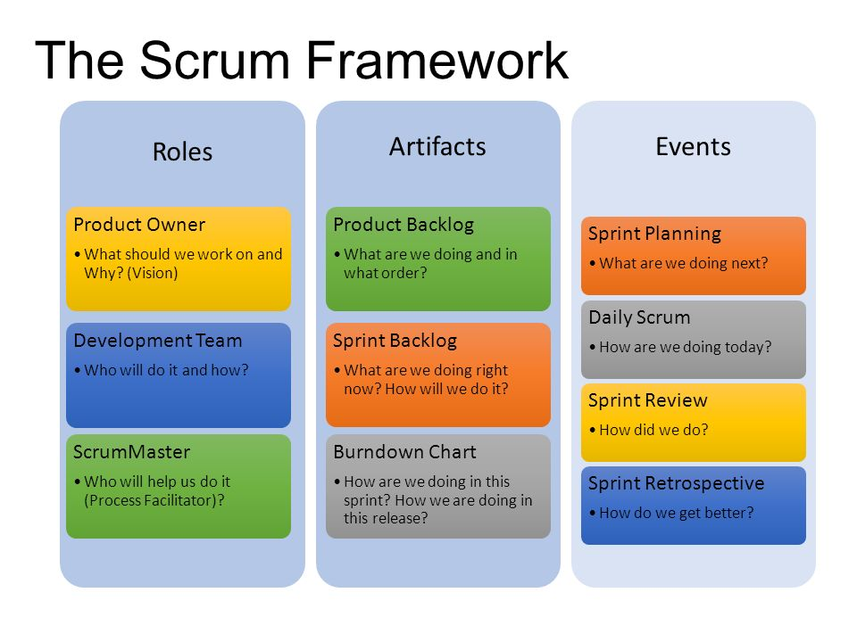
Scrum Overview

Slide 36
Time to get our hands dirty

Slide 37
Class Activity
Break into Agile Teams
Pick Roles
Develop a product backlog
Pick a sprint goal
Have a sprint planning meeting
Develop sprint backlog
Write code and test… in our heads
Deploy… in our heads

Slide 38
Key Terminologies

Slide 39
Story Points
Key Terminologies
A story point is an abstract measure of effort required to implement a user story
It is a number that tells the team about the difficulty level of the story. Difficulty could be related to complexities, risks, efforts involved and time/duration
In most cases a story point uses one of the following scales for sizing:
1,2,4,8,16
X-Small, Small, Medium, Large, Extra-Large ( known as “T-Shirt Sizing”)
Fibonacci sequence: 0,1,1,2,3,5,8,13,21,…..
Notes:
https://confluence.interswitch.com/confluence/pages/viewpage.action?pageId=25527379

Slide 40
Scrum Team Velocity
Key Terminologies
Velocity is a measure of the amount of work a team can tackle during a single Sprint
Velocity is calculated at the end of the Sprint by totaling the points for all fully completed
Points from partially-completed or incomplete stories should not be counted in calculating velocity
A team's velocity will oscillate from Sprint to Sprint
It is used to forecast how many stories a team can do in a Sprint
For forecasting purposes the average of the last three Sprint's Velocity should be used
Notes:
For forecasting purposes the average of the last three Sprint's Velocity should be used. Of course, this means it takes three Sprints of experience for a Team to determine its Velocity accurately

Slide 41
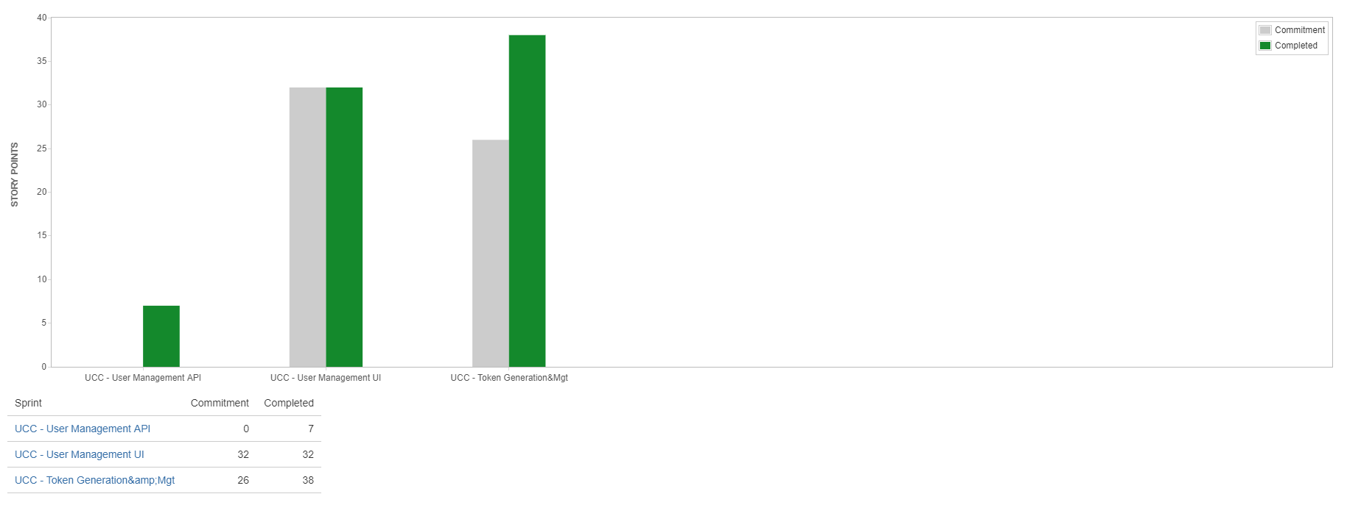
Scrum Team Velocity
Key Terminologies

Slide 42
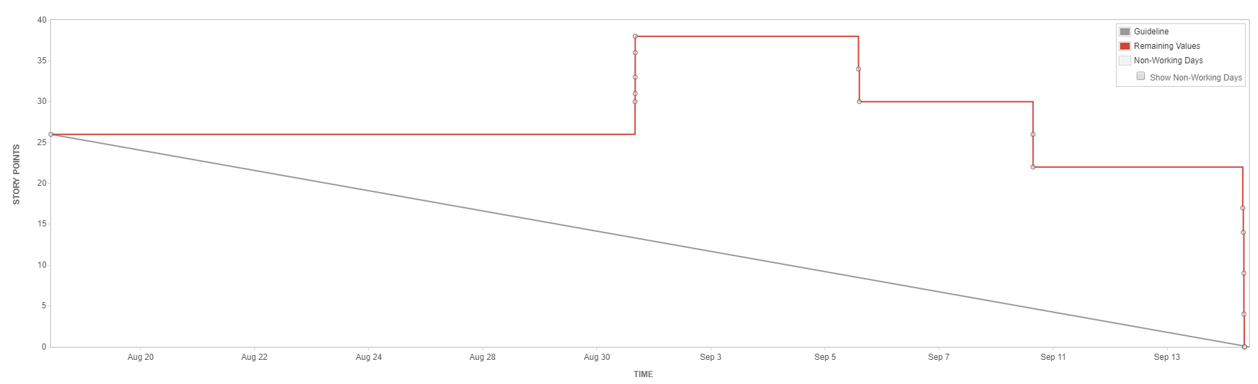
Burn Down Chart
Key Terminologies
A burn down chart is a graphical representation of work left to do versus time or the amount of work that has been completed in an epic or sprint, and the total work remaining
A chart used to track the total work remaining and project the likelihood of achieving the sprint goal
Notes:
https://jira.interswitch.com/jira/secure/RapidBoard.jspa?rapidView=188&projectKey=PD&view=reporting&chart=burndownChart&sprint=2462

Slide 43
Burn Down Chart
Key Terminologies
If the team consistently finishes work early, this might be a sign that they aren't committing to enough work during sprint planning.
If the team consistently miss their forecast, this might be a sign that they've committed to too much work.
Notes:
or forecasting purposes the average of the last three Sprint's Velocity should be used. Of course, this means it takes three Sprints of experience for a Team to determine its Velocity accurately

Slide 44
Sprint Zero
Key Terminologies
The main benefit of a Sprint Zero is that it allows a team to get an idea of the work ahead of them
Sprint Zero seeks to avoid the obstacle of delving into a project without clarity by offering an opportunity to plan a framework for success and ensure a working Sprint environment
Sprint Zero should be used to create the basic skeleton and plumbing for the project
Minimal design up front is done in Sprint Zero so that emergent design is possible in future sprints
For minimal design up front, the team picks up a very few critical stories and develops them to completion
The velocity of Sprint Zero is usually very low compared to that of other sprints
Runs usually for a week or less
Notes:
Sprint Zero should be used to create the basic skeleton and plumbing for the project so that future sprints can be truly add incremental value in an efficient way. It may involve some research spikes.
Minimal design up front is done in Sprint Zero so that emergent design is possible in future sprints. This includes putting together a flexible enough framework so that refactoring is easy.
For minimal design up front, the team picks up a very few critical stories and develops them to completion. Since these are the first few stories, delivering them includes putting the skeleton/framework in place, but even Sprint Zero delivers value.

Slide 45
Pros
Pros & Cons of Scrum
Improved product quality
Higher customer satisfaction ratings
Increased control over project development
Faster turnaround of ROI
Fewer risks
Experimentation and idea testing is easier to do as cost is low

Slide 46
Cons
Pros & Cons of Scrum
Poor or difficult estimation
Limited or no documentation
Difficult progress Measurement
Scope creep and experience rot
Poor Design
Features that are too big to fit into one or even several cycles are avoided because they don’t fit in nicely into the philosophy
Technical debt
No finite end
Poor resource planning
Notes:
Poor Design: Short cycles don’t leave enough time for the design thinking process so designers have to redevelop the experience over and over due to negative feedback
Technical debt: Teams can get sidetracked into delivering new functionality at the expense of technical debt, which increases the amount of unplanned work
No finite end: Projects can become ever-lasting because there’s no clear end
Poor resource planning: When developers run out of work, they can’t work on a different project because they’ll be needed soon

Slide 47
Agile works best when
Pros & Cons of Scrum
You can’t estimate the time you’ll need and don’t know the full scope of requirements
You don’t know whether there’s a need on the market for your software
You can’t map out the business needs so the design needs to emerge through trial and error
You have unlimited access to your customer who’s ready for extensive involvement
You can afford to iterate and don’t need to deliver a fully functional software at once
Neither you nor your client have a complex bureaucracy that delays decision
Clients don’t have a fixed budget/schedule
You need to capture the market before there’s any competition
Your customers don’t have trouble updating their software (or don’t even notice it, e.g. they use a web app)

Slide 48
Scrum Alternative: Kanban

Slide 49
Kanban
Kanban is the Japanese word for "visual signal” or “a card you can see”
It is a popular framework used to implement agile software development
Work items are represented visually on a Kanban board to give the team a view of progress and process/workflow especially in a service or technology team where work is often invisible or intangible
The board may be physical or digital
Kanban is great for teams focused on continuous delivery with changing priorities
It aims to manage work by balancing the demands with available capacity
Kanban board helps limit work-in-progress
It can be applied to any area of work like manufacturing
The Kanban values are respect for people and continuous improvement
Kanban boards comprises a commitment point, delivery point, cards and columns
A combination of Scrum and Kanban can be used
Notes:
One advantage of a physical board is that it’s “always on.” It’s simple to set up, simple to show others, and is often times the better way to communicate with certain teams. However, physical boards are not ideal for remote teams or people with terrible handwriting, like me. The advantages of a digital kanban board are the speed to set it up, the ease in sharing it with others, and the ability to asynchronously track an infinite number of conversations and comments as the project progresses.

Slide 50
Kanban
Difference between Scrum and Kanban
Scrum sprints have start and stop dates whereas Kanban is an ongoing process.
Team roles are clearly defined in scrum (product owner, dev team, and scrum master), while Kanban has no formal roles. Both teams are self-organized.
A Kanban board is used throughout the lifecycle of a project whereas a scrum board is cleared and recycled after each sprint.
A scrum board has a set number of tasks and strict deadline to complete them.
Kanban boards are more flexible with regards to tasks and timing. Tasks can be reprioritized, reassigned, or updated as needed.
Notes:
One advantage of a physical board is that it’s “always on.” It’s simple to set up, simple to show others, and is often times the better way to communicate with certain teams. However, physical boards are not ideal for remote teams or people with terrible handwriting, like me. The advantages of a digital kanban board are the speed to set it up, the ease in sharing it with others, and the ability to asynchronously track an infinite number of conversations and comments as the project progresses.

Slide 51
Thank you
Notes:
inspect and adapt understanding - link to events
RACI for agile events

